Slide 1
Remapping validation progress
2/16/18

Slide 2
Intra observer error focusing solely on the manual landmarks
Method 1: Standard deviation between the raw x, y, and z values

Slide 3
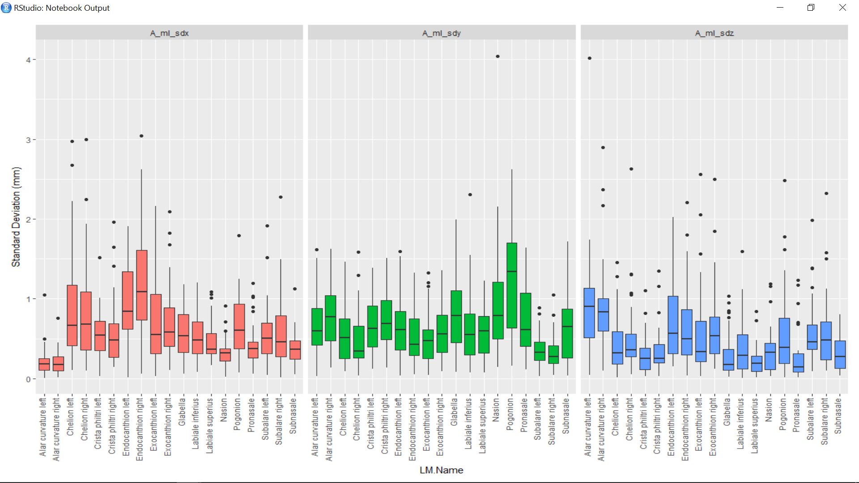
Notes:
Standard deviation between Arslan’s three iterations for the x, y, and z values.

Slide 4
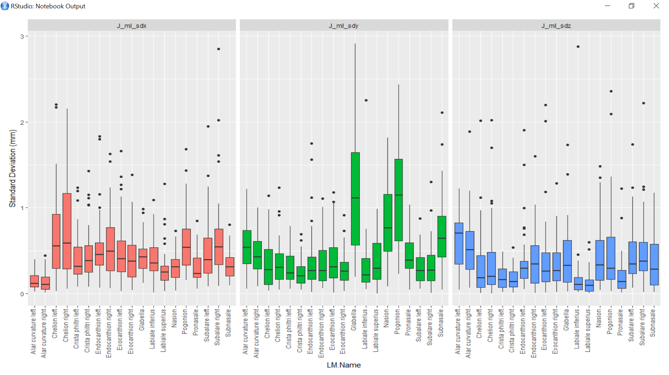
Notes:
Standard deviation between Arslan’s three iterations for the x, y, and z values.

Slide 5
Intra observer error focusing solely on the manual landmarks
Method 2: Euclidean distances between each observers iterations and the centroid of all their iterations

Slide 6
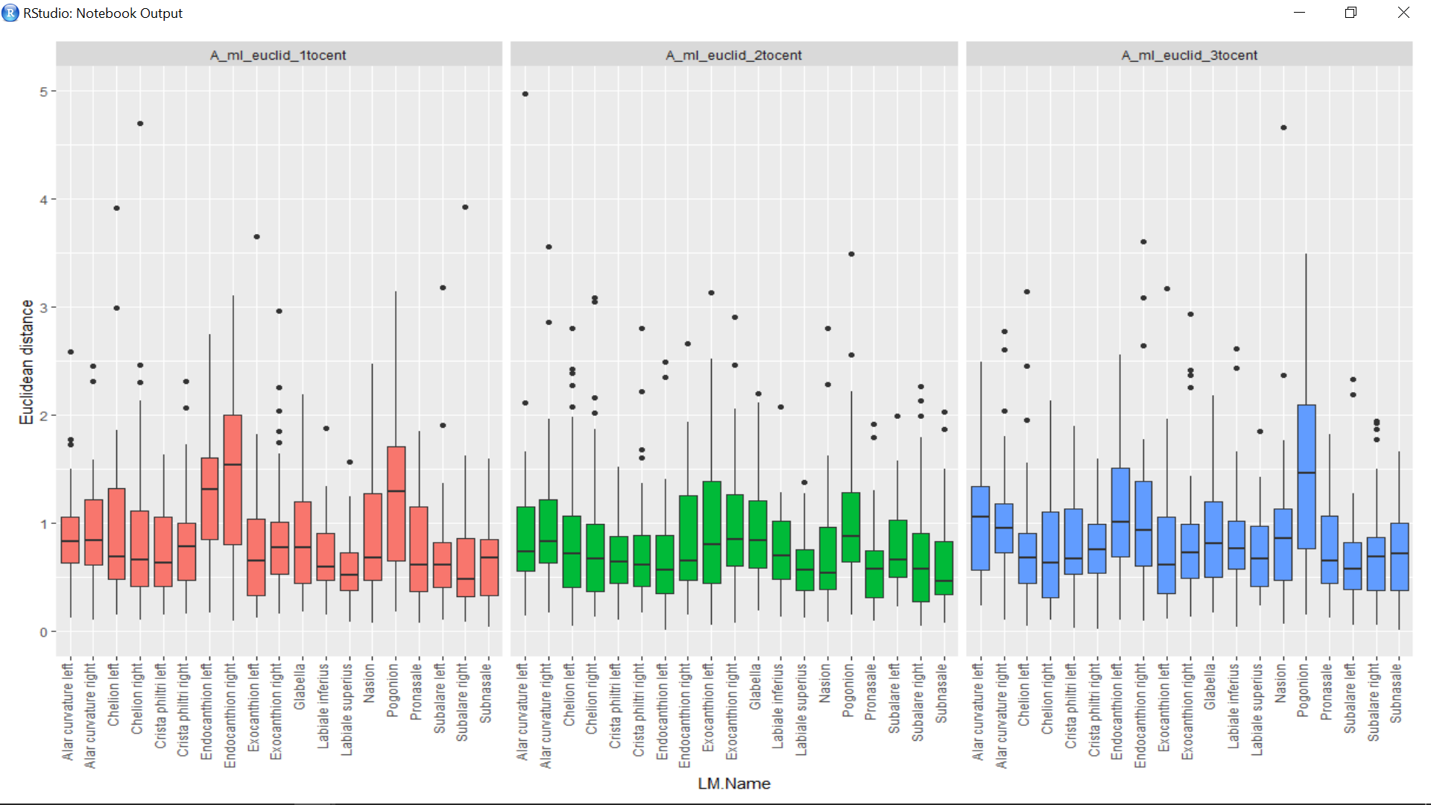
Notes:
Euclidean distances between each of Arslan’s iterations and the centroid of his iterations.

Slide 7
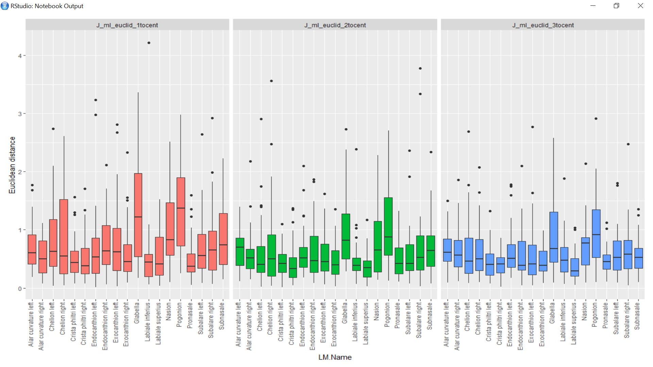
Notes:
Euclidean distances between each of Julie’s iterations and the centroid of his iterations.

Slide 8
Intra observer error focusing solely on the manual landmarks
Method 3: Pairwise euclidean distances between each observers iterations and all of their other iterations

Slide 9
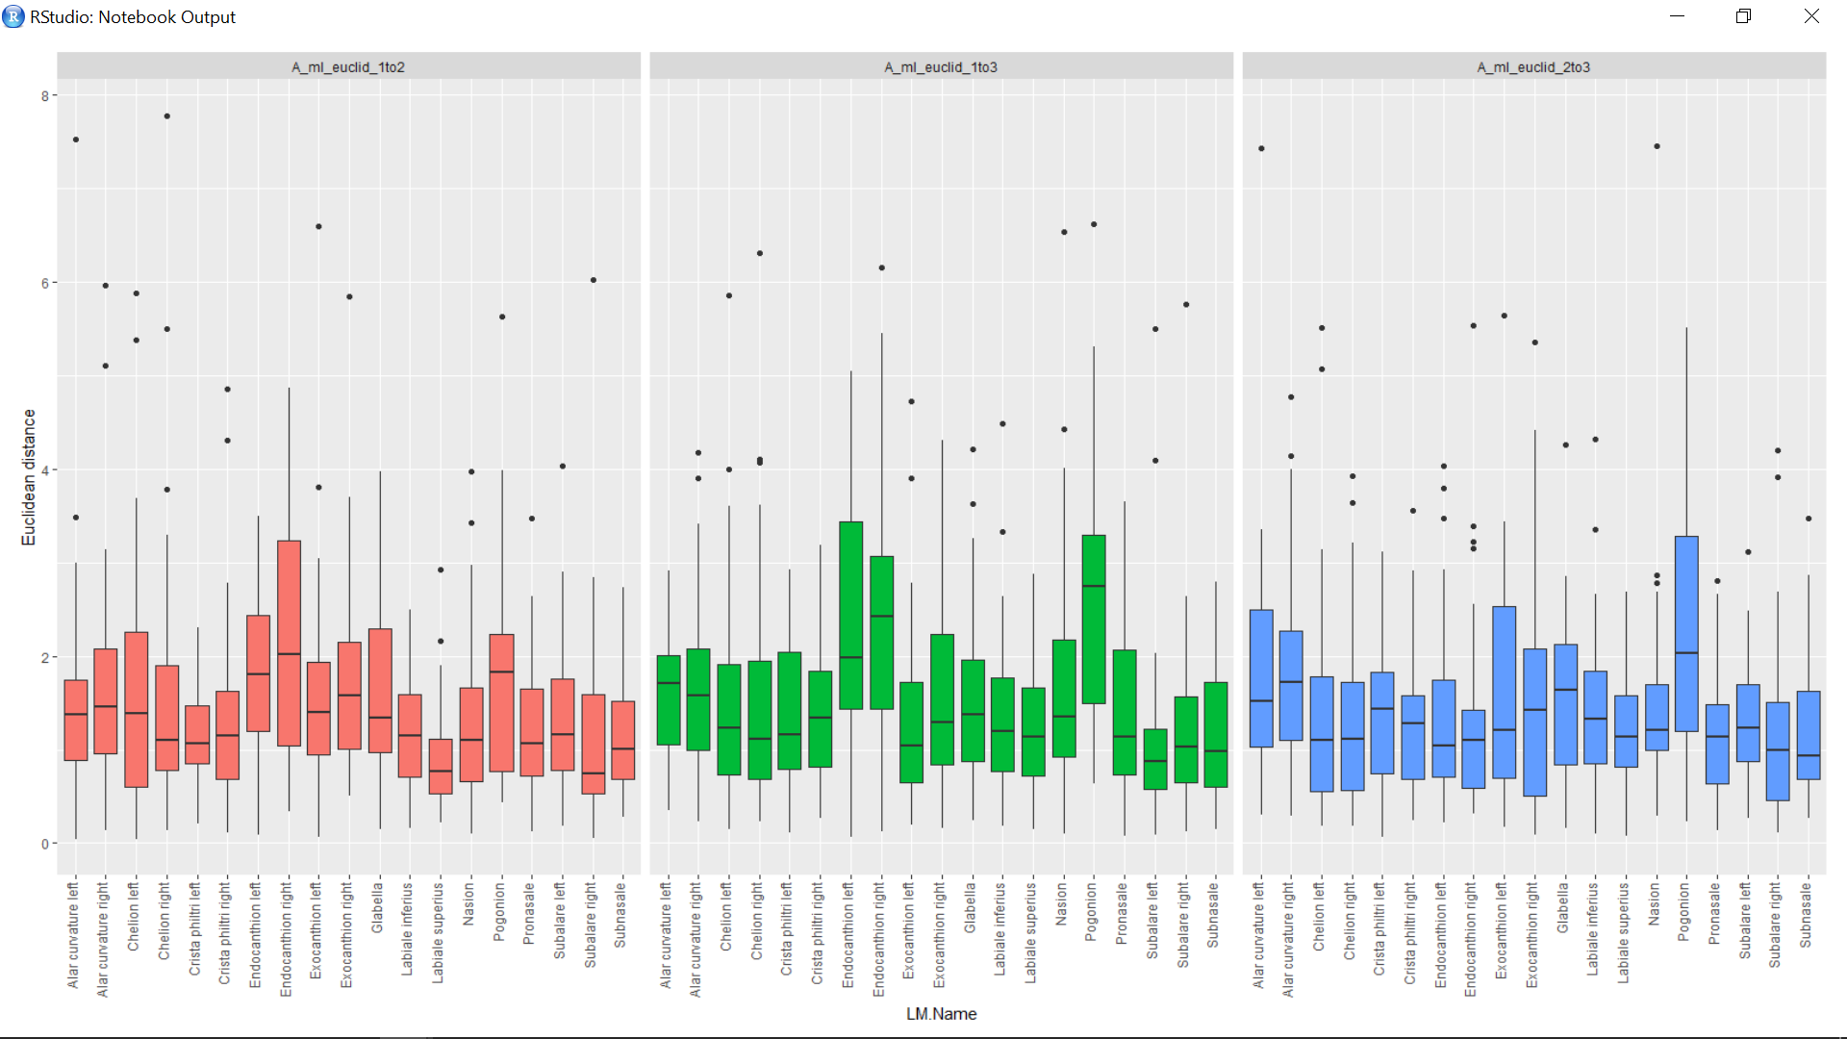
Notes:
Pairwise Euclidean distances between all of Arslan’s iterations and all of his other iterations.

Slide 10
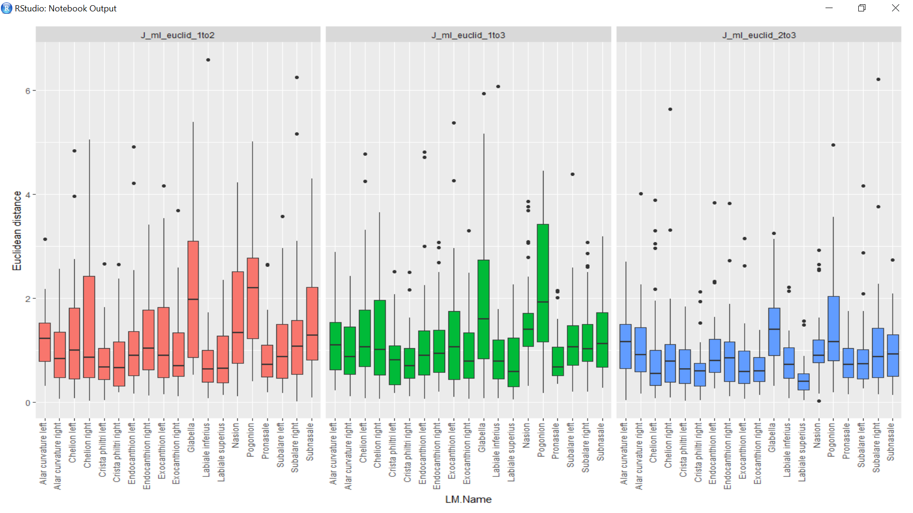

Slide 11
Inter observer error focusing solely on the manual landmarks
Method 1: Standard deviation between all of the iterations from both raters
Sdx = Sd(A_x1, A_x2, A_x3, J_x1, J_x2, J_x3)

Slide 12
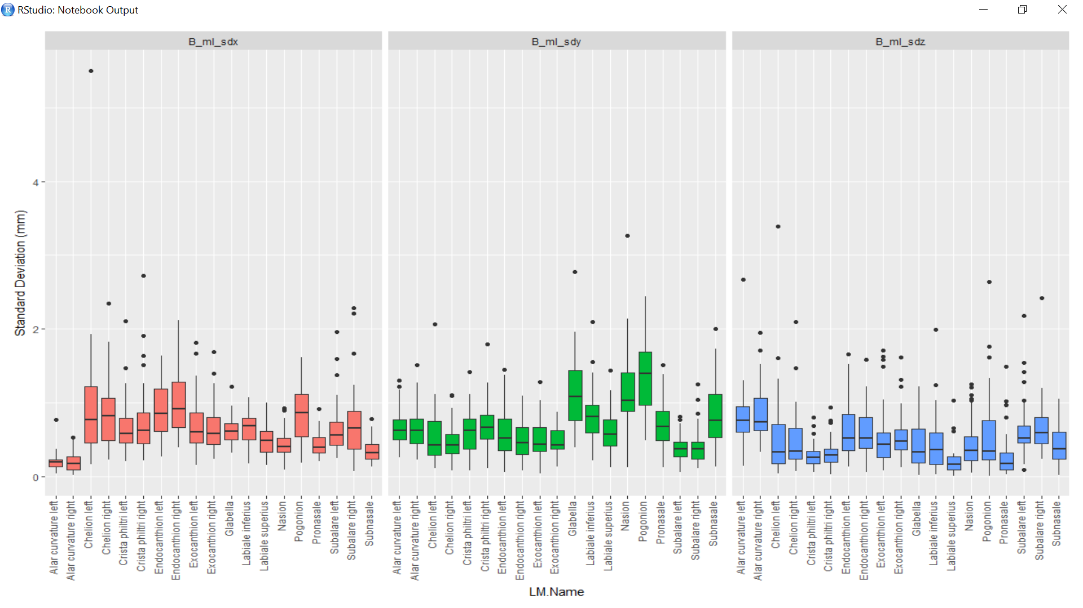
Notes:
Standard deviation between all six iterations (three from Arslan and three from me)

Slide 13
Inter observer error focusing solely on the manual landmarks
Method 2: Euclidean distance from each of the iterations from each rater to the centroid of all six iterations.
Centroid_x = mean(A_x1, A_x2, A_x3, J_x1, J_x2, J_x3)

Slide 14
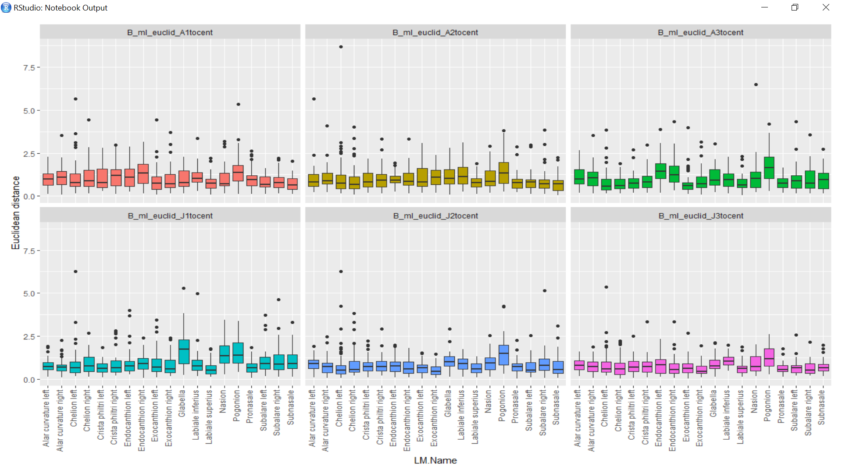
Notes:
Distance from each of the six iterations to the centroid of all of the iterations

Slide 15
Inter observer error focusing solely on the manual landmarks
Method 3: Pairwise euclidean distance from each of the iterations from each rater to each of the other iterations

Slide 16
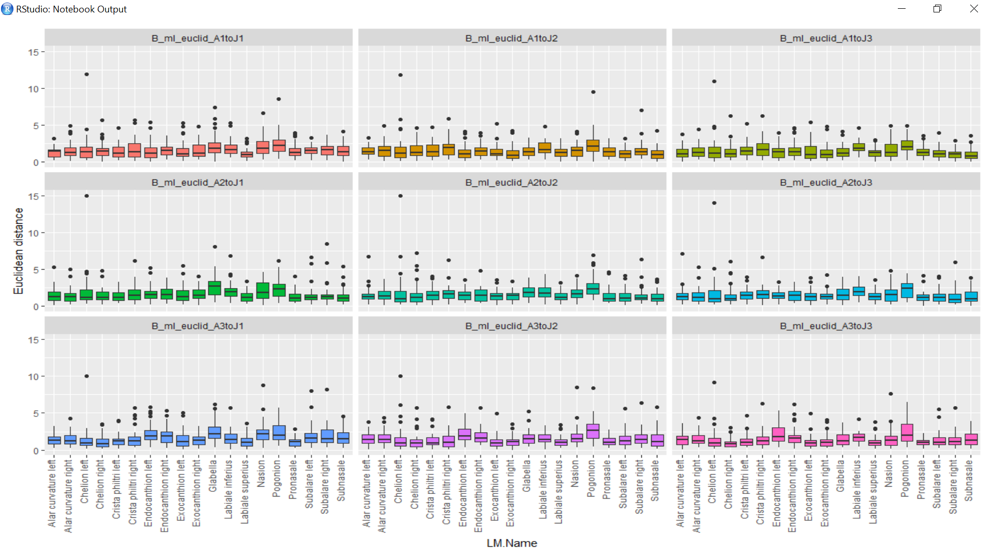
Notes:
Euclidean distance between each of one rater’s iterations to each of the other rater’s iterations

Slide 17
Comparison of raw manual landmarks intra vs inter errors using Euclidean distance methods

Slide 18
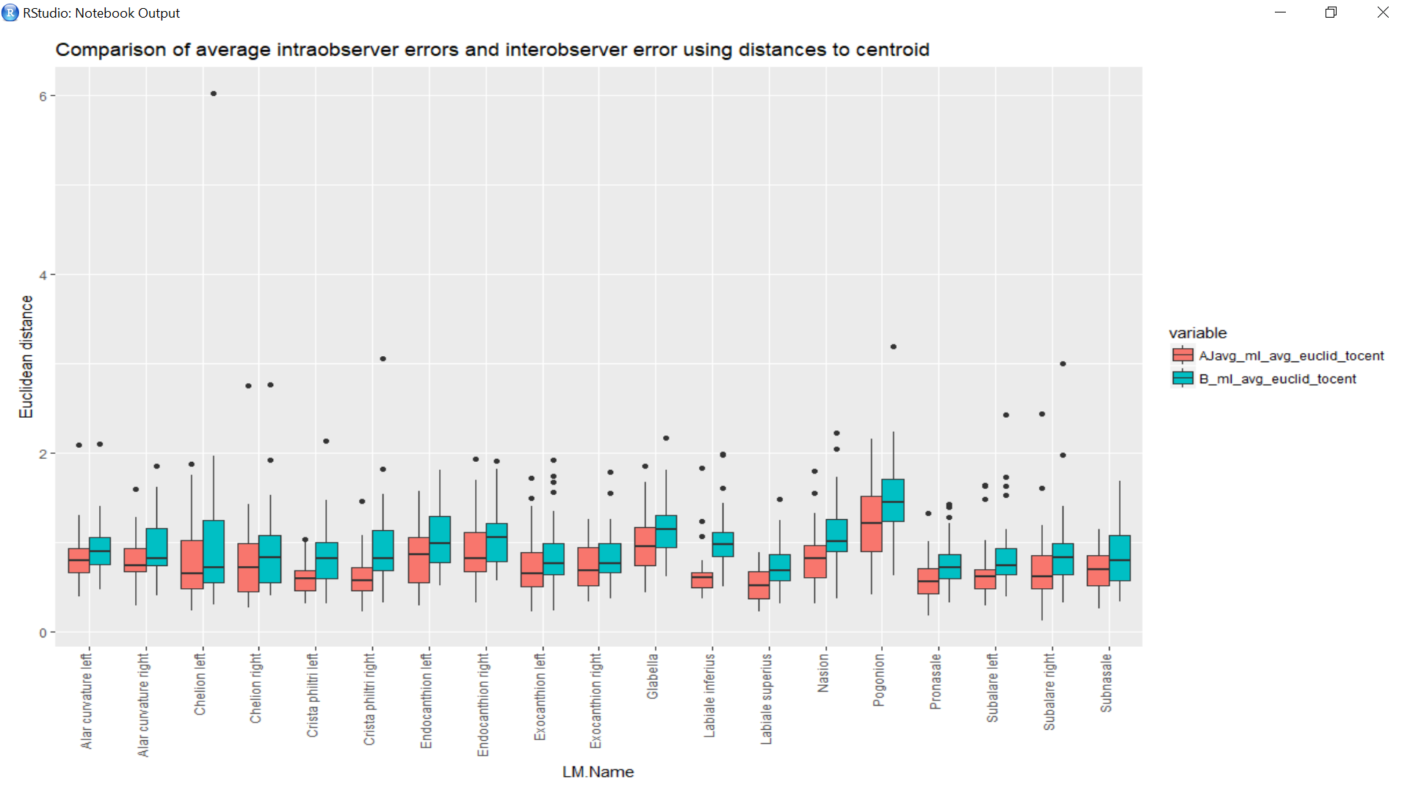
Notes:
AJavg = the average of Arslan’s Euclidean distances and my Euclidean distances to our respective centroids (intra)
B = The average of all six Euclidean distances, one for each rater’s iteration to the centroid (inter)

Slide 19
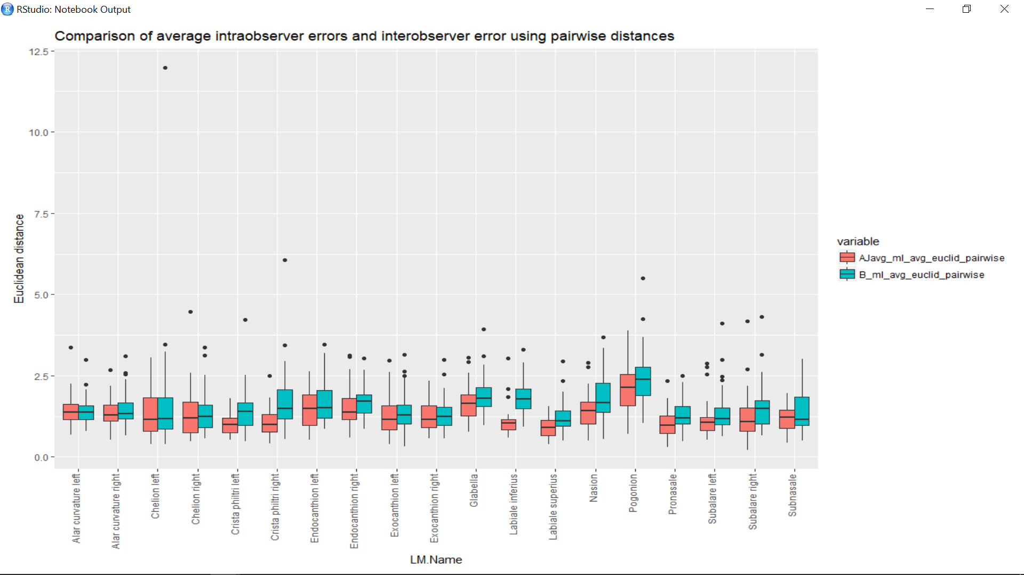
Notes:
AJavg = the average of Arslan’s Euclidean distances and my Euclidean distances to our respective centroids (intra)
B = The average of all nine Euclidean distances, one for each rater’s iteration to all of the other rater’s iterations (inter)

Slide 20
Euclidean distance from raw manual landmarks to Peter’s average landmarks on the facial surface

Slide 21
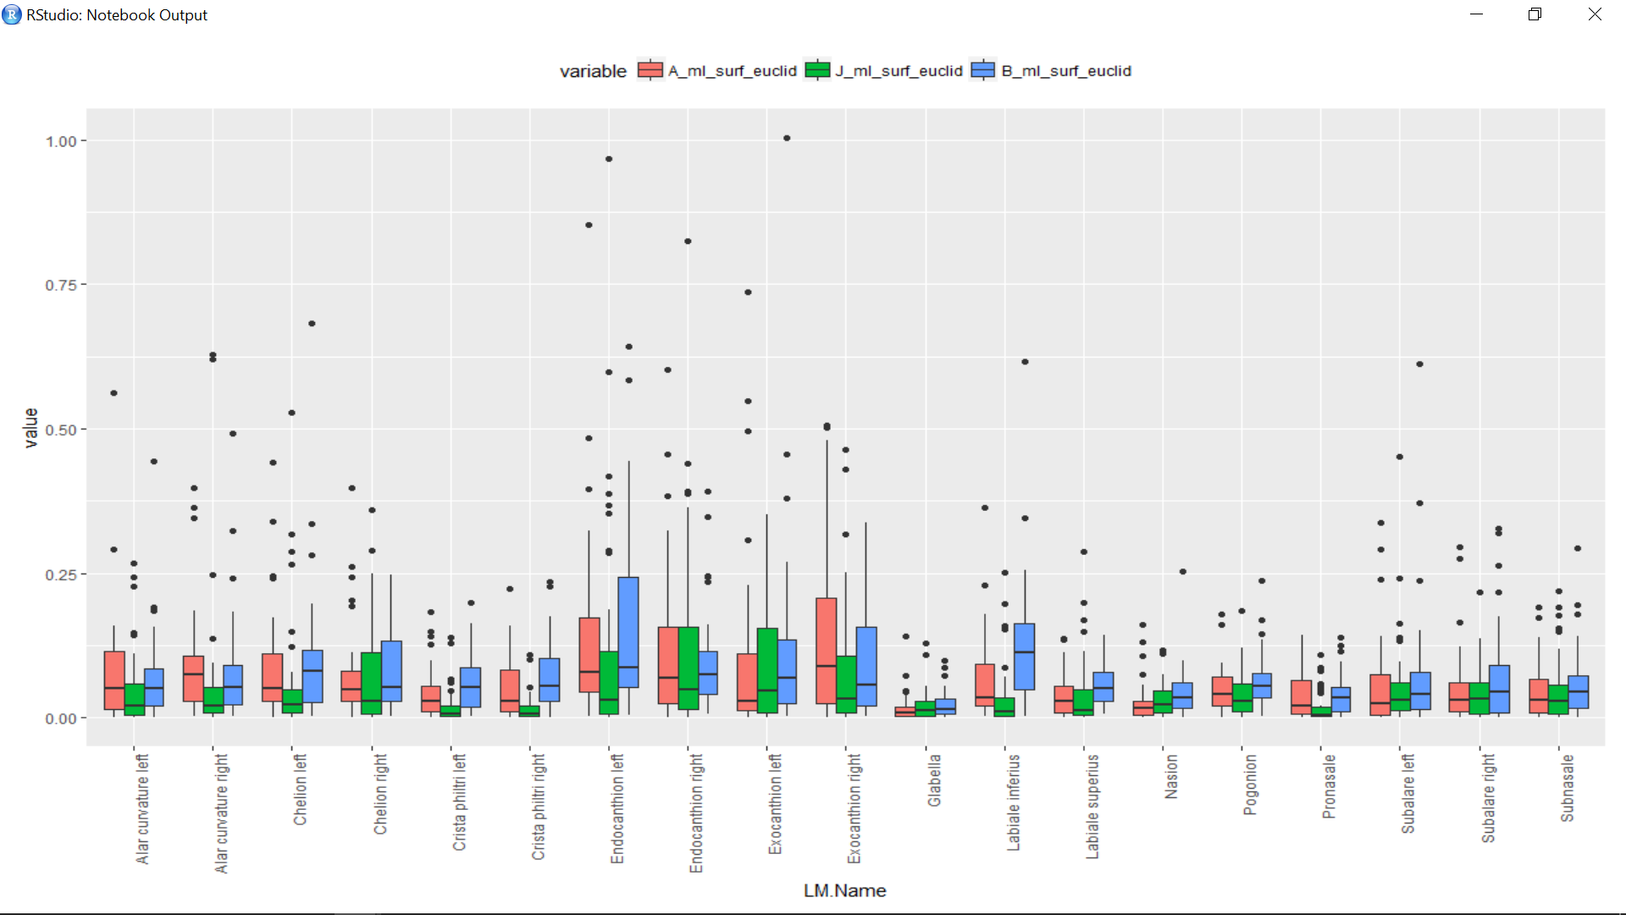

Slide 22
Euclidean distance of raw manual landmarks to Peter’s automatic landmarks

Slide 23
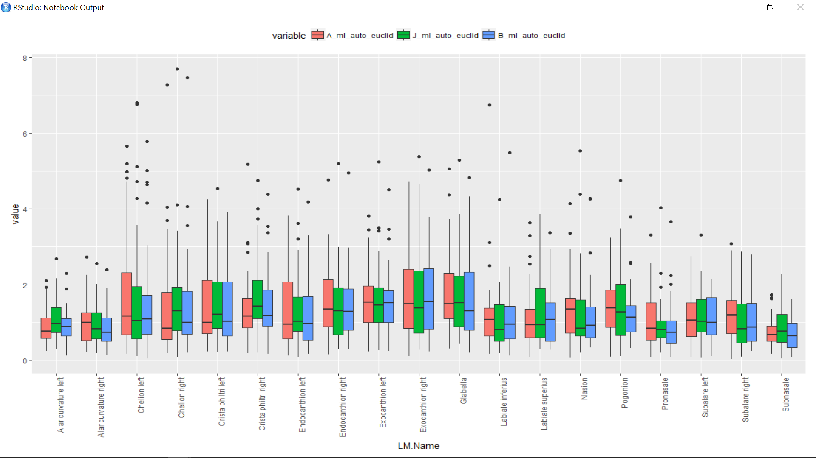

Slide 24
Error measures on Peter’s landmarks as Euclidean distances from each “observer” to the centroid of all three “observers”

Slide 25
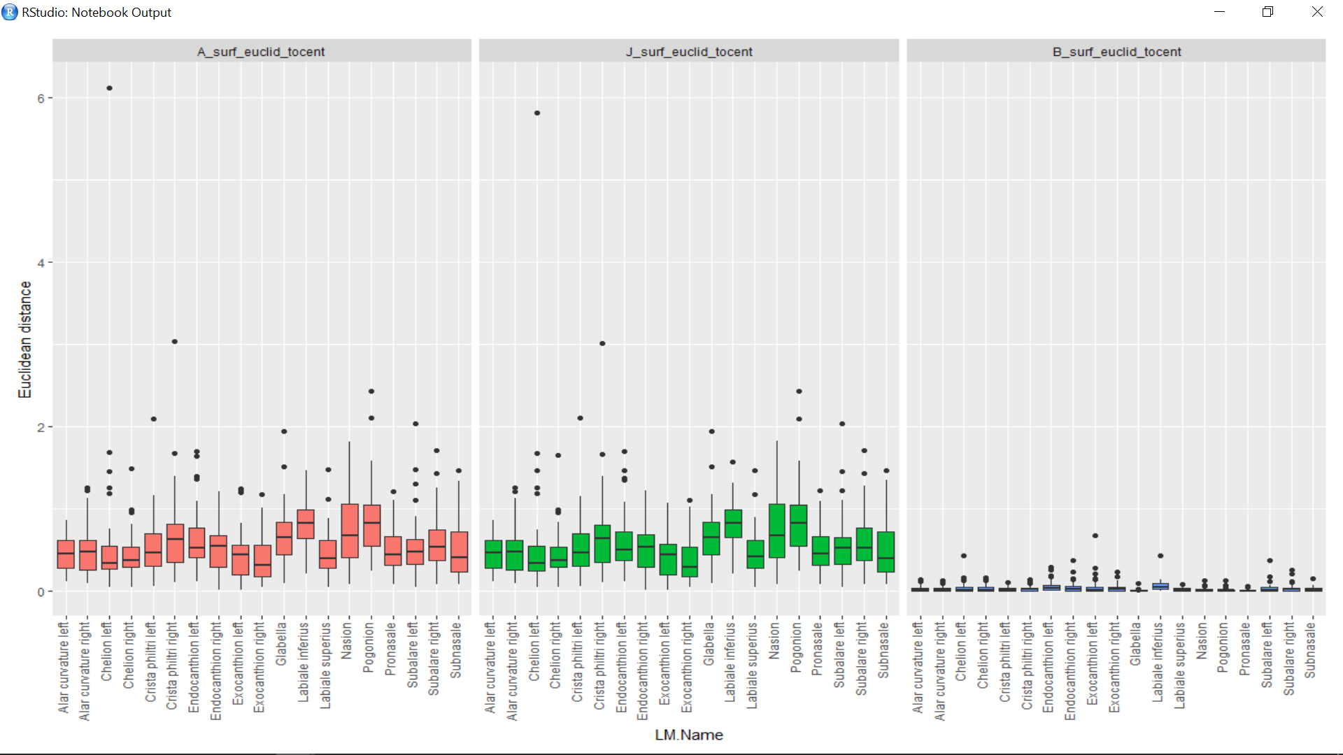
Notes:
Centroid = center of the three raters: 1) surface landmarks only Arslan’s average landmarks, 2) surface landmarks only Julie’s average landmarks, 3) surface landmarks using both Julie and Arslan’s average landmarks
First panel (A) = distance from the surface landmarks using only Arslan’s averages to the centroid
Second panel (J) = distance from the surface landmarks using only Julie’s averages to the centroid
Third panel (B) = distance from the surface landmarks using all six iterations (three from A, three from J) to the centroid

Slide 26
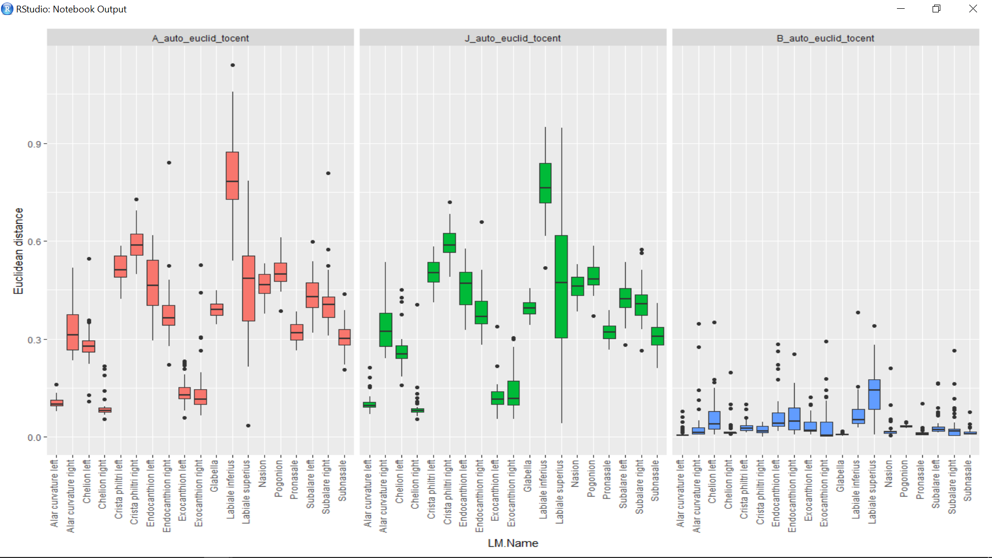
Notes:
Centroid = center of the three raters: 1) automatic landmarks trained using only Arslan’s average landmarks, 2) automatic landmarks trained using only Julie’s average landmarks, 3) automatic landmarks trained using both Julie and Arslan’s average landmarks
First panel (A) = distance from the automatic landmarks trained using only Arslan’s averages to the centroid
Second panel (J) = distance from the automatic landmarks trained using only Julie’s averages to the centroid
Third panel (B) = distance from the automatic landmarks trained using all six iterations (three from A, three from J) to the centroid

Slide 27
Comparison of errors for Peter’s surface landmarks and automatic landmarks

Slide 28
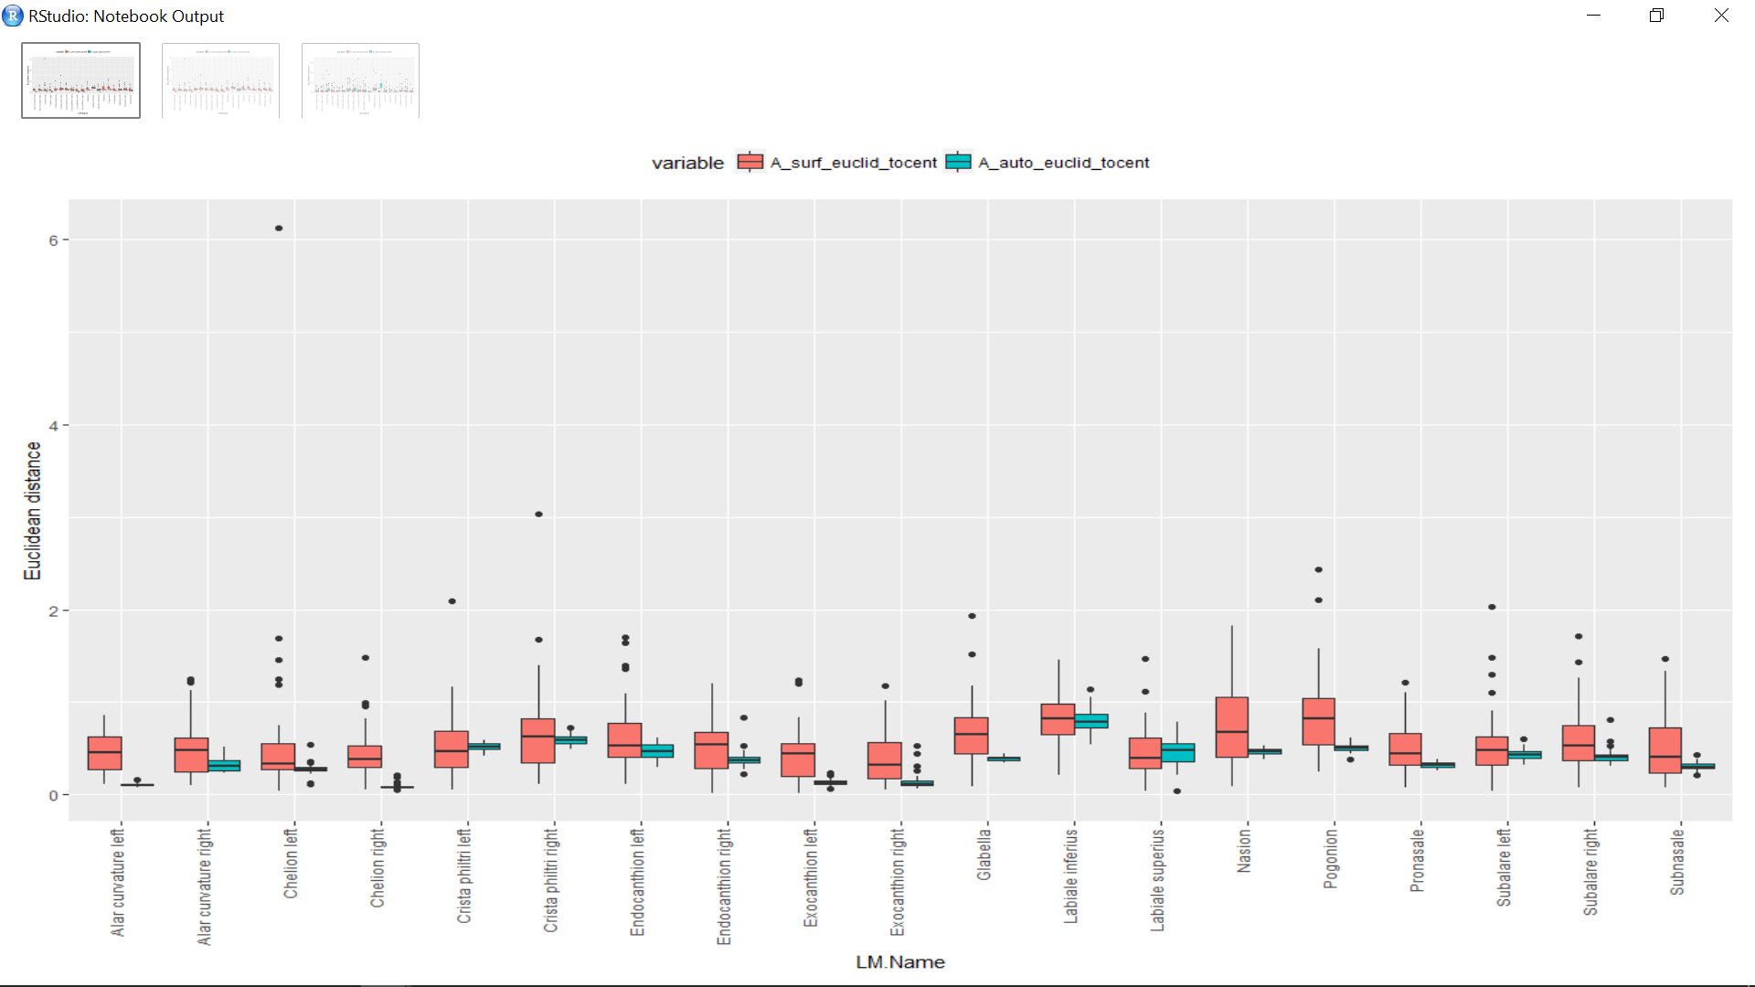
Notes:
From Arslan’s data:
A_surface_Euclid_tocent =distance from the surface landmarks using only Arslan’s averages to the centroid (panel 1 from slide 25)
A_auto_Euclid_tocent = distance from the automatic landmarks trained using only Arslan’s averages to the centroid (panel 1 from slide 26)

Slide 29
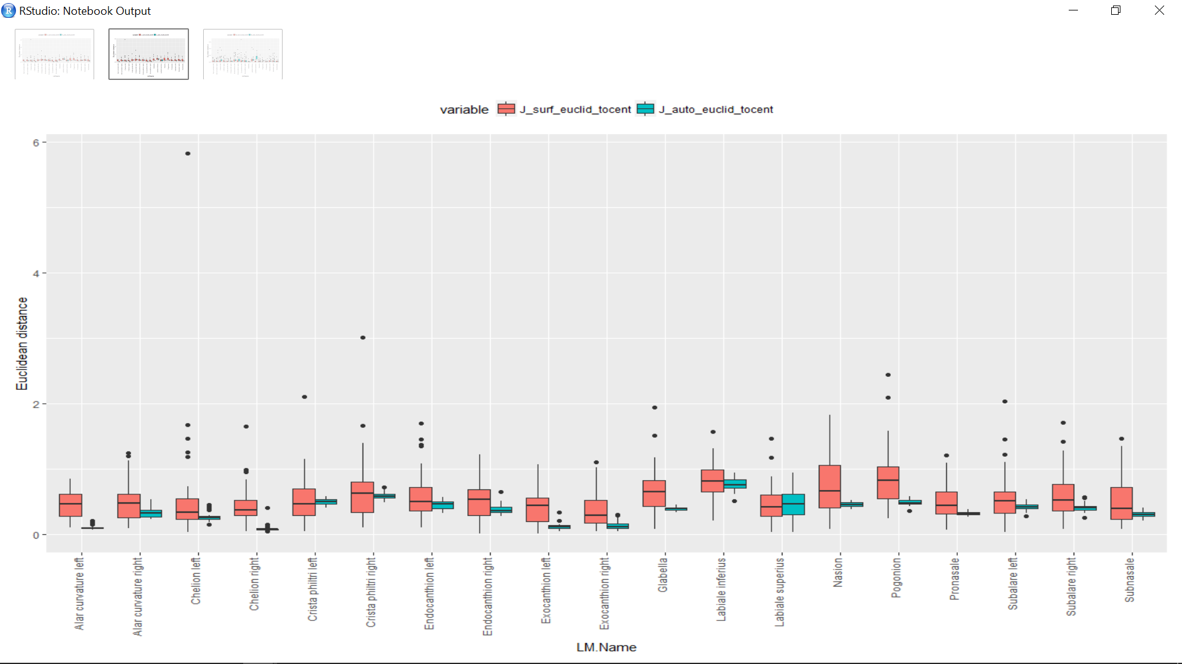
Notes:
From Julie’s data:
J_surface_Euclid_tocent =distance from the surface landmarks using only Julie’s averages to the centroid (panel 2 from slide 25)
J_auto_Euclid_tocent = distance from the automatic landmarks trained using only Julie’s averages to the centroid (panel 2 from slide 26)

Slide 30
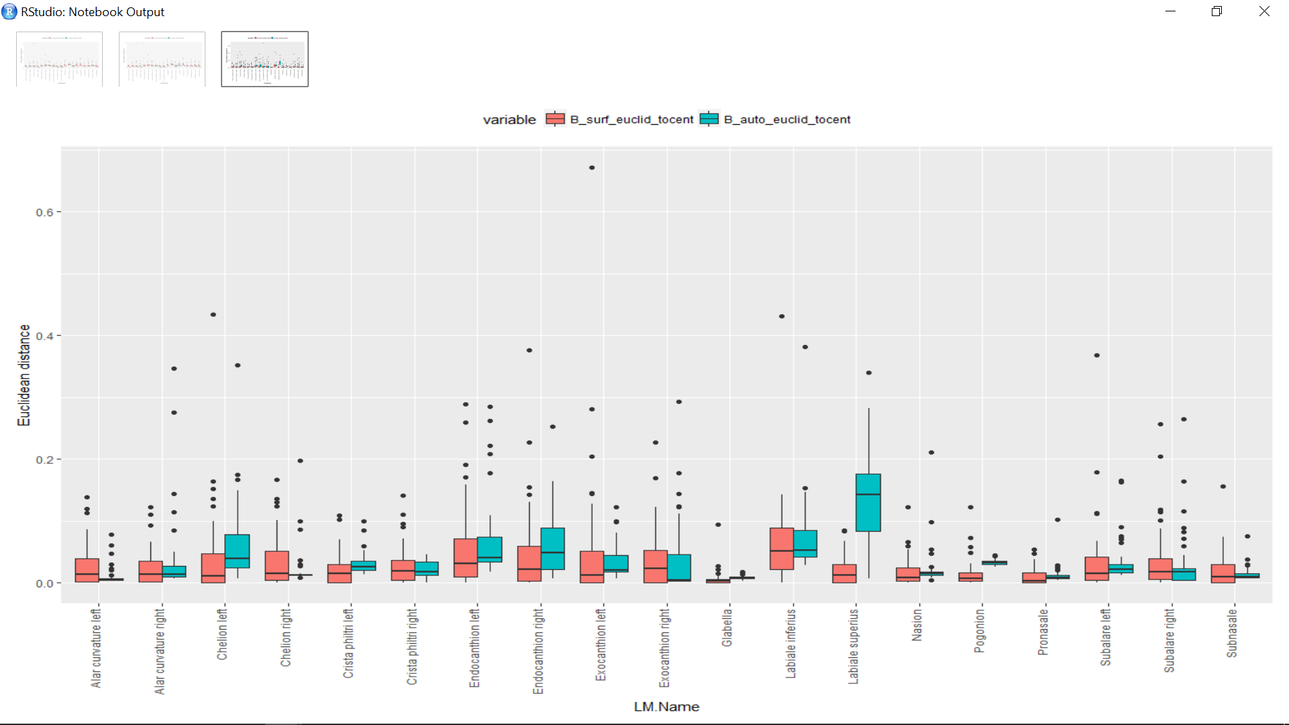
Notes:
From the average of Arslan and Julie’s data:
B_surface_Euclid_tocent =distance from the surface landmarks using the average of all Arslan and Julie’s data to the centroid (panel 3 from slide 25)
B_auto_Euclid_tocent = distance from the automatic landmarks trained using the average of all Arslan and Julie’s data to the centroid (panel 3 from slide 26)

Slide 31
Comparison of centroid sizes

Slide 32
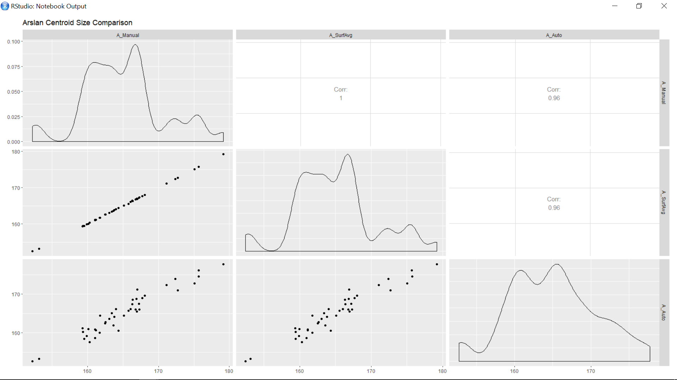
Notes:
Centroid size calculated from:
The average landmarks from Arslan’s manual data
Peter’s average landmarks on the surface using Arslan’s data
Automatic landmarks trained using Arslan’s iterations

Slide 33
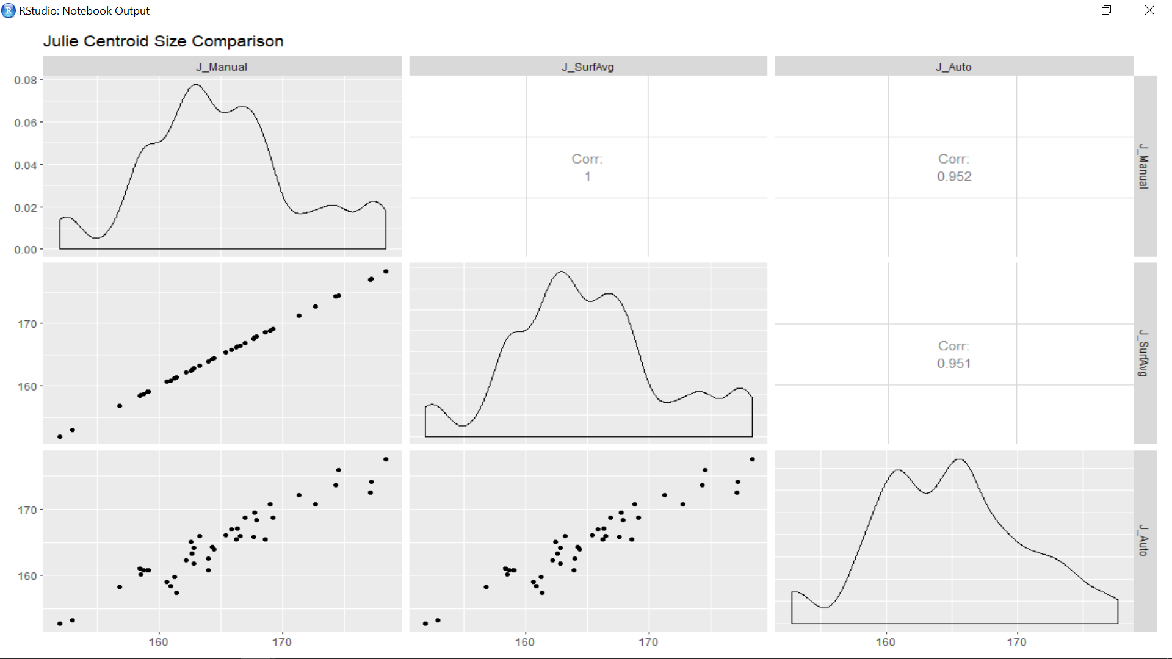
Notes:
Centroid size calculated from:
The average landmarks from Julie’s manual data
Peter’s average landmarks on the surface using Julie’s data
Automatic landmarks trained using Julie’s iterations

Slide 34

Notes:
Centroid size calculated from:
The average landmarks from all six manual landmarking iterations (three from Arslan, three from me)
Peter’s average landmarks on the surface using all six iterations
Automatic landmarks trained using all six iterations

Slide 35
Two block partial least squares
Used to compare the covariation structure between the manual landmarks and the automatic landmarks
All have high R2 values (>0.973) and significant p-values (0.001)
This means that the two methods (manual and automatic) yield variance-covariance matrices that are highly correlated

Slide 36
To do
MANOVA for shape with individual, observer, and trial as factors
ANOVA for centroid size by individual between methods
Compare an external dataset that wasn’t “trained” on?

